Slide 1
Assessing Robustness Of AI-based Systems In The Face Of Human-based Exploitative Uncertainty
Kenneth H. Chan
A Dissertation
Michigan State University, Fall 2025
Advisor: Dr. Betty H.C. Cheng
Committee members: Dr. Shaunak Bopardikar, Dr. Qiben Yan, Dr. Joshua E. Siegel

Slide 2
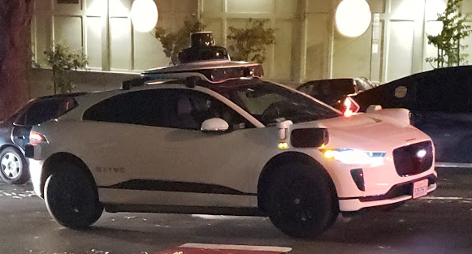
Learning-enabled systems
Modern advances in Artificial Intelligence (AI)-based systems has shown promising results [1, 2, 3, 4, 5]
Commonly integrated in safety-critical systems [6]
Learning-Enabled Component (LEC):
system components whose behaviors
are optimized by training
Learning-Enabled Systems (LES):
systems that involve one or more LEC(s)

Slide 3
Challenges
Current state-of-the-art can even outperform humans [7, 8]
Performance is closely tied with training data
Machine Learning (ML) has been demonstrated to
Be susceptible to adversarial noise [9]
Exhibit undesirable behavior in previously unseen scenarios [10]
i.e., those that are not captured in training data
When deployed in operating contexts involving humans,
safety-critical LES(s) must be robust and safe — even when facing uncertainty

Slide 4
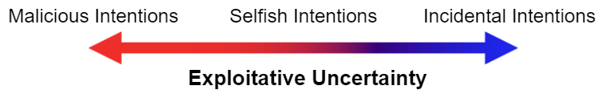






Exploitative Uncertainty
This dissertation proposal focuses on a specific type of uncertainty: Human-based Exploitative Uncertainty
Uncertainty: Incomplete data
Human-based: Originating from humans in the environment
Exploitative: Human intentions that take advantage of one or more conditions of the AI-based system
Notes:
Weather
Jaywalking
Aggressive driver
Cyber security – Driving way too quickly that put other vehicles at risk (puts other vehicles at risk) - Roomba (water)

Slide 5
Uncertainty in machine learning
Epistemic uncertainty [11, 12]
Can be reduced by gaining more information
E.g., Driving extra cautiously at a poorly designed intersection
Aleatoric uncertainty [11, 12]
Cannot be reduced by any additional sources of information†
E.g., Noise affecting sensor inputs
† Without Laplace’s demon

Slide 6
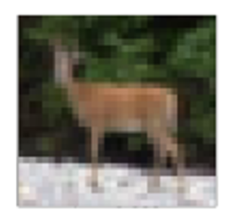
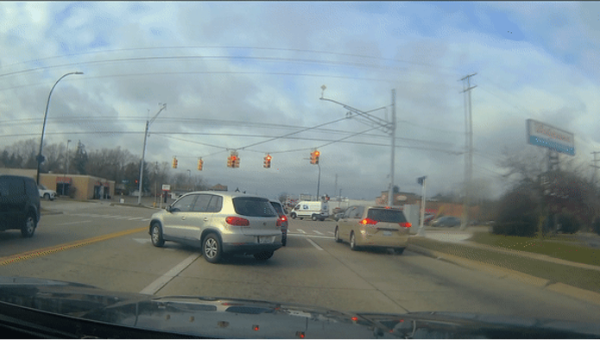
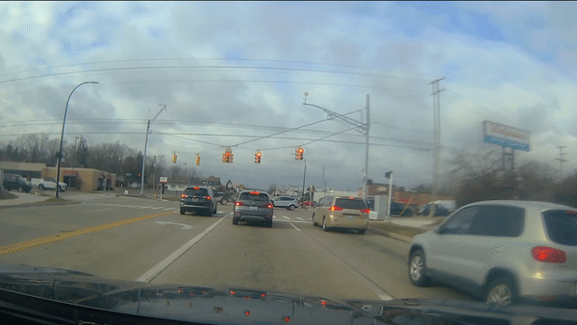
Machine learning testing
To reduce epistemic uncertainty, we can test how they respond to different previously unseen inputs [13]
Challenge: The space of possible inputs is large
DNN input dimensions:
32*32*3

Slide 7
Finding the needle in the haystack
Finding failures during testing allows us to address the problem before deployment
Software reconfiguration
Addition of safeguards
Updates to ML models through retraining
Updates to roadway infrastructure or policies
These failures serve as test cases to assess the robustness of our system
Notes:
Robustness: the ability of a DNN to perform its task correctly even when facing uncertainty

Slide 8
Thesis Statement
Search-based methods can serve as a foundation and be synergistically integrated with other techniques to assess and facilitate the improvement of the robustness of AI-based systems when exposed to exploitative-based uncertainty from external human agents.

Slide 9
Objective-driven and Diverse Data
We design and develop testing techniques that generates data with an emphasis on
Targeted (objective-driven) misbehaviors in the LEC/LES
Diverse misbehaviors in the LEC/LES

Slide 10


Visualization
Space of all possible inputs
Ground truth
ML model
Correctly learned data
Targeted test case
Diversity-driven test case

Slide 11
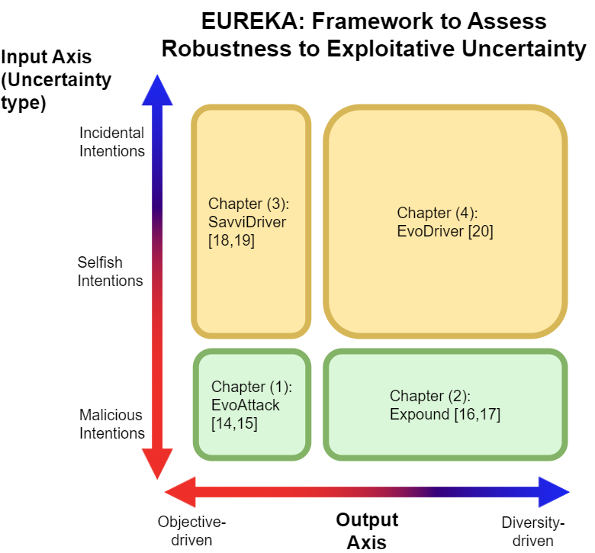
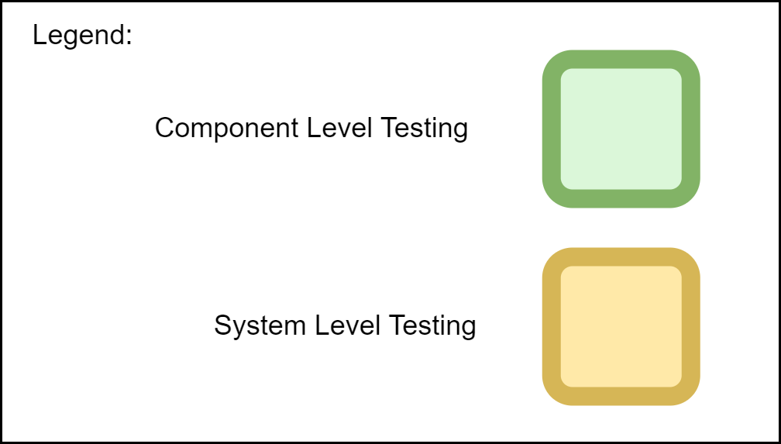

Slide 12
Overarching common objectives
Automated approaches
Focus on the generation of test cases for AI-enabled systems
Agnostic to model, simulator, data, and application
Leverage multidisciplinary techniques
Complements and supplements existing testing techniques
Notes:
Not limited to traditional SE. So we are adding multidisciplinary to supplement SE. Search base is a multidisciplinary
Not amenable to traditional testing approaches

Slide 13
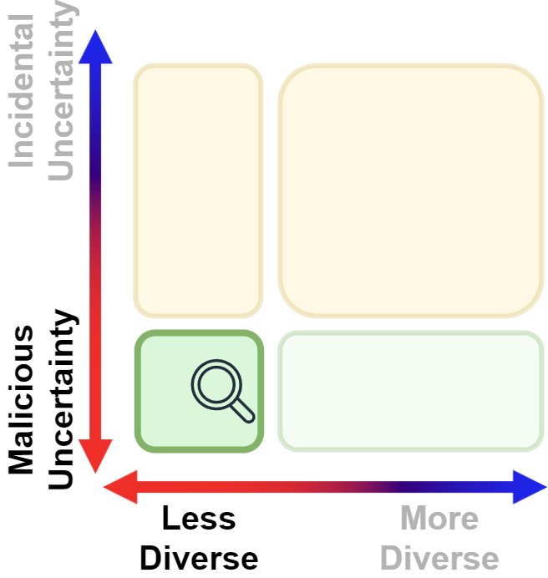
EvoAttack
[14] Kenneth H Chan and B.H.C. Cheng. EvoAttack: An evolutionary search-based adversarial attack for object detection models. In Proceedings of the 14th IEEE Symposium on Search-Based Software Engineering, pages 83-97, Singapore, 2022
[15] Kenneth H Chan and B.H.C. Cheng. EvoAttack: Suppressive adversarial attacks against object detection models using evolutionary search. Automated Software Engineering, vol. 32, no. 3, 2025

Slide 14
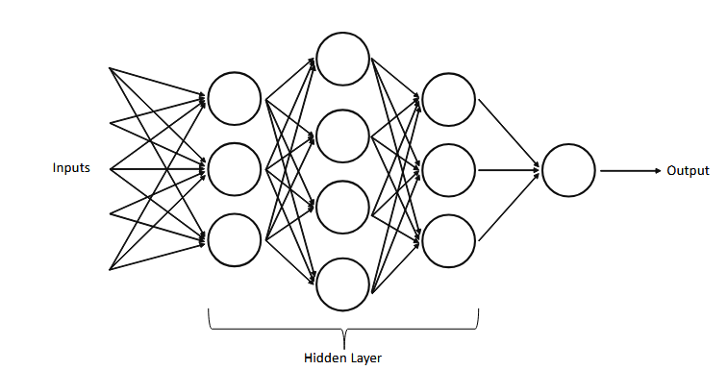
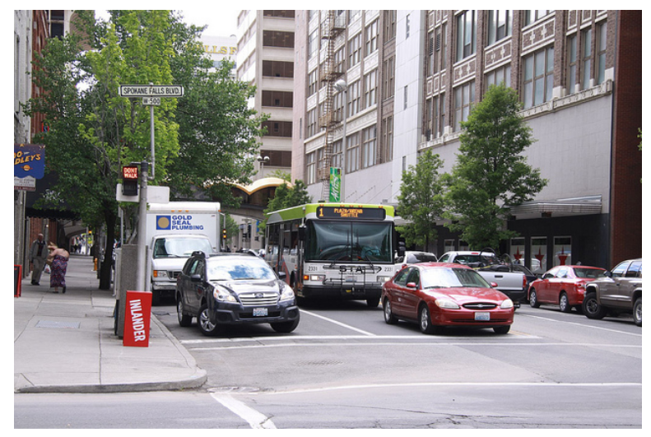
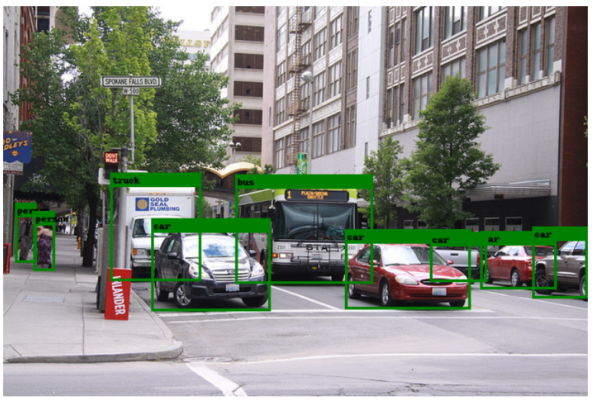
Context for EvoAttack
Asset to be protected: LEC
Object detectors
Threat: malicious human-based exploitative uncertainty
Type of data generated: single type of failure
Notes:
Q: is this slide better at the end of the chapter?

Slide 15
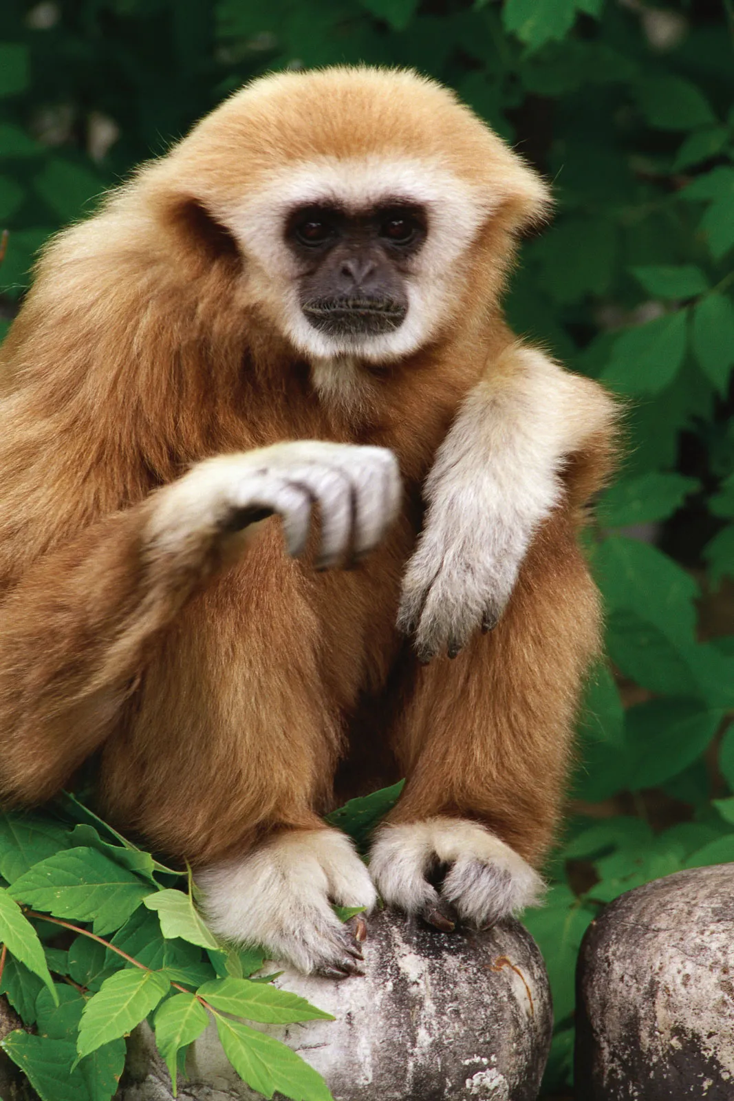
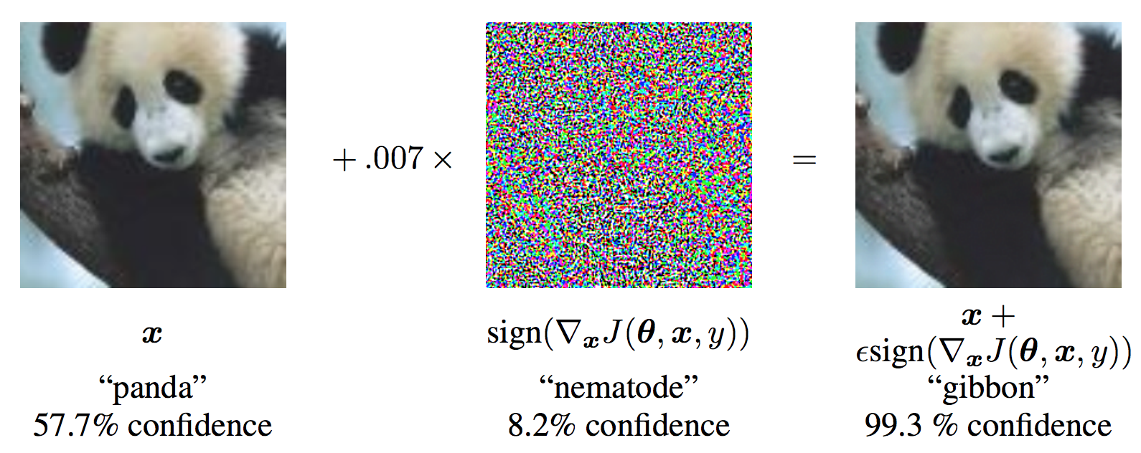
Adversarial examples
https://www.britannica.com/animal/gibbon-primate
Intriguing property of ML algorithms [9, 21]
Susceptible to minor perturbations
Leads to misbehavior in ML
Goodfellow et al. [22]

Slide 16
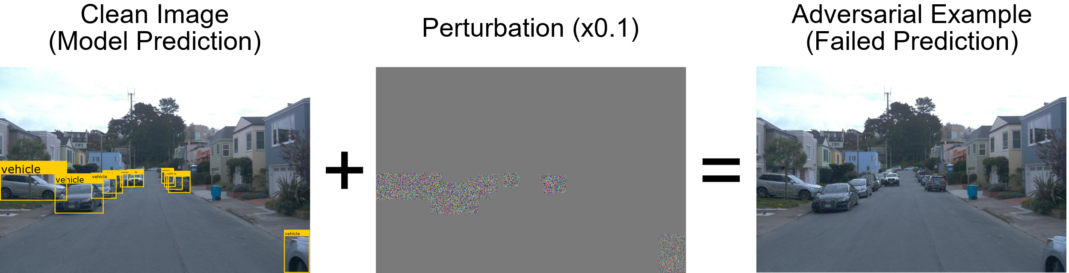
Adversarial examples for object detectors
Existing approaches studied their effects on image classifiers [9, 21, 22, 23]
Always produces one output that causes the LEC to misclassify inputs
We describe an approach to generate a new kind of testing data
Suppress the ability of the DNN to identify any of the objects in the input
Notes:
Discuss importance of suppressing vs misclassifying

Slide 17
Methodology
We use a refined Genetic Algorithm with various domain-specific optimization to discover optimal (and minimal) noise
Black-box
Gradient-free
Does not require a surrogate model
Data, model, and domain agnostic

Slide 18
Validation
Datasets (data agnosticism)
Microsoft COCO dataset [24]
Waymo Open dataset [25]
VisDrone dataset [26]
Models (model agnosticism)
Faster RCNN (two shot model) [27]
RetinaNet with ResNet50 as backbone (one shot model) [28]
YoloV5 (one shot model) [29]
Applications (domain agnosticism)
Everyday objects
Autonomous driving
Autonomous drone flying

Slide 19
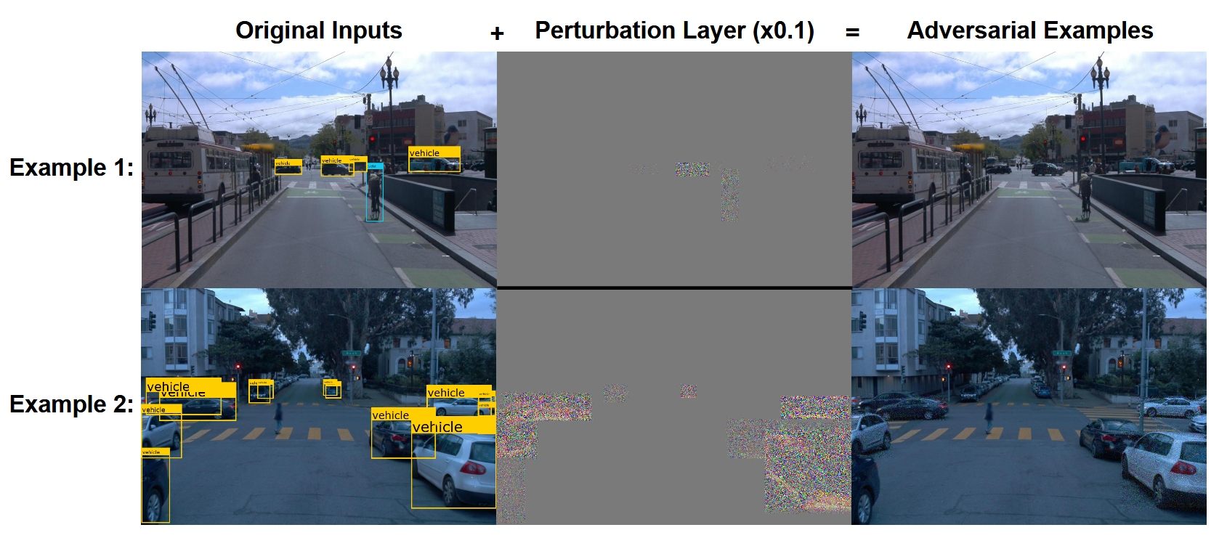
Waymo data

Slide 20
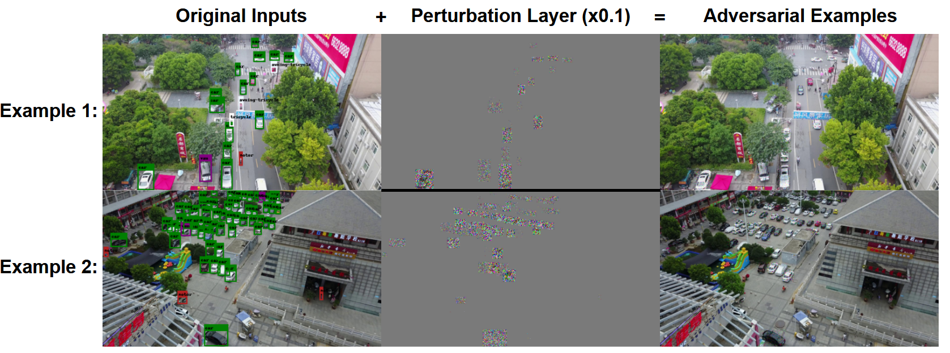
VisDrone data

Slide 21
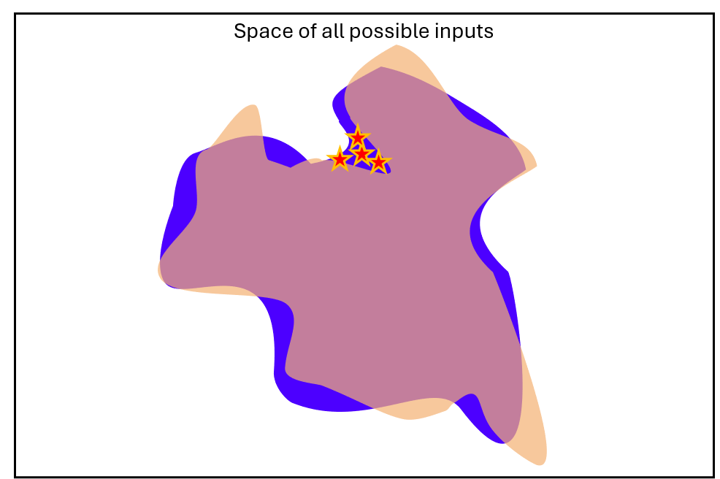
Summary
Innovation and impact on community
New class of adversarial examples, seeking to suppress object detection
Technical approach
Demonstrated that adversarial examples extends to state-of-the-art object detection algorithms
Model, data, and domain agnostic approach

Slide 22
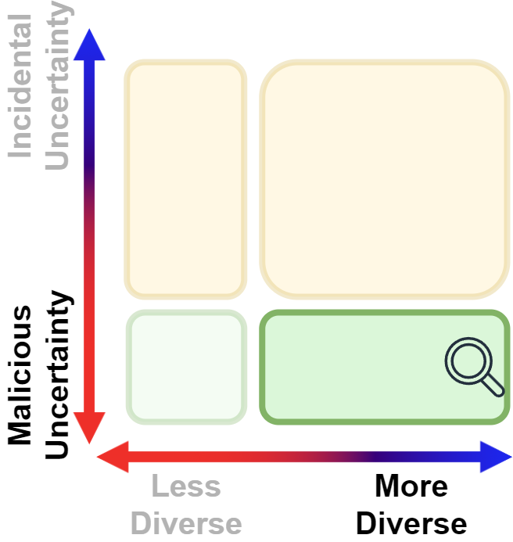
Expound
[16] Kenneth H Chan and B.H.C. Cheng. Expound: A black-box approach for generating diversity-driven adversarial examples. In International Symposium on Search Based Software Engineering, pages 19–34. Springer, 2023
[17] Kenneth H Chan and B.H.C. Cheng. Expound: a diversity-driven black-box approach for categories of model and domain-agnostic adversarial examples, 2025. (Submitted for publication to the Journal of Automated Software Engineering)

Slide 23
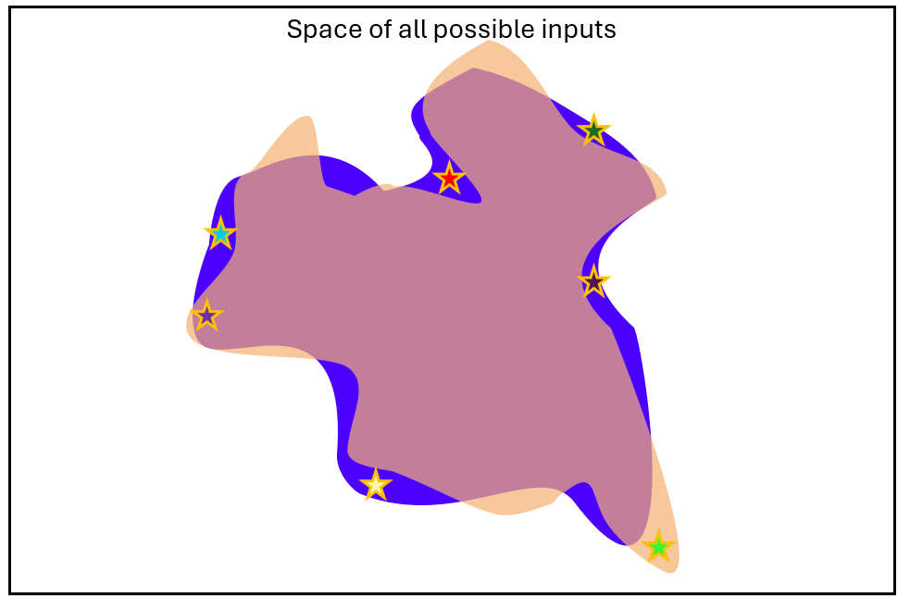
Expound Overview
Asset to be protected: LEC
Image classifiers
Threat: malicious human-based exploitative uncertainty
Type of data generated: Diversity-driven
Notes:
Underline and make stars bigger
Left sotat including evo
Right expound

Slide 24
Challenges with existing techniques
Always generates one sample
White-box approaches [9, 21, 22, 23]
Significant assumptions
Developer / attacker need to choose the target label
Black-box approaches [30, 31, 32, 33]
Infers gradient information (leads to the same label)
CIFAR10: 10 possible labels

Slide 25
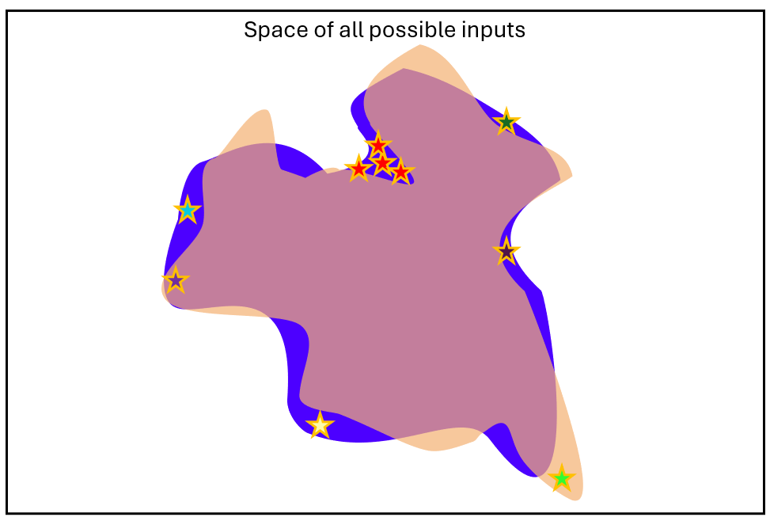
Why diversity
Diversity has been shown to better identify limitations and weaknesses of ML models [34, 35, 36, 37]
Remove bias from testing
Identifies more than one way a model can fail
Better data for robustification

Slide 26
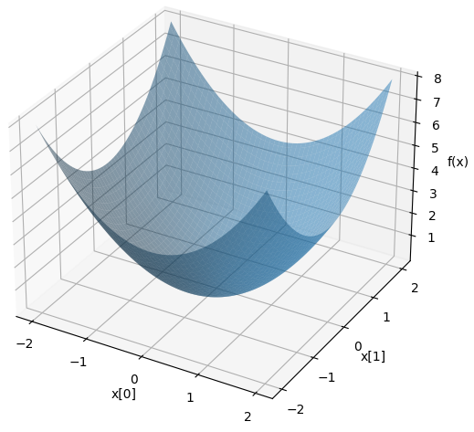
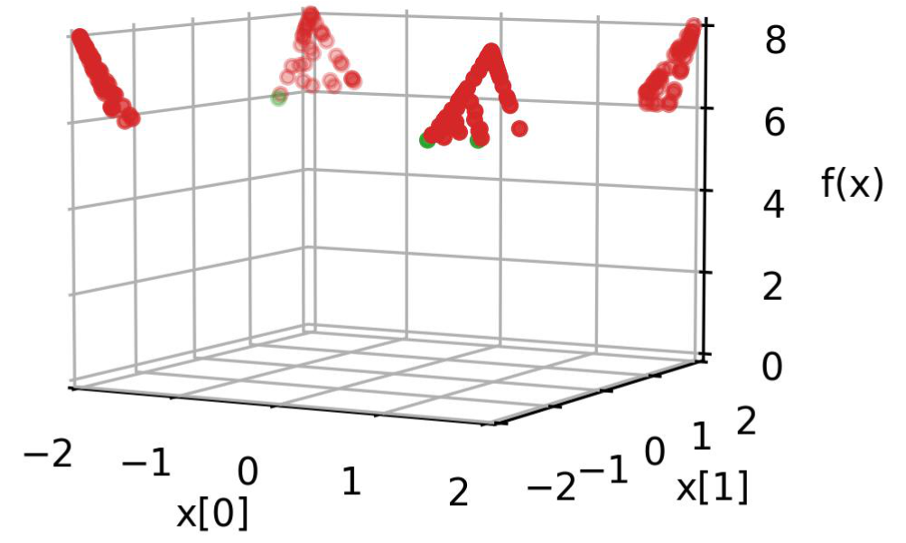
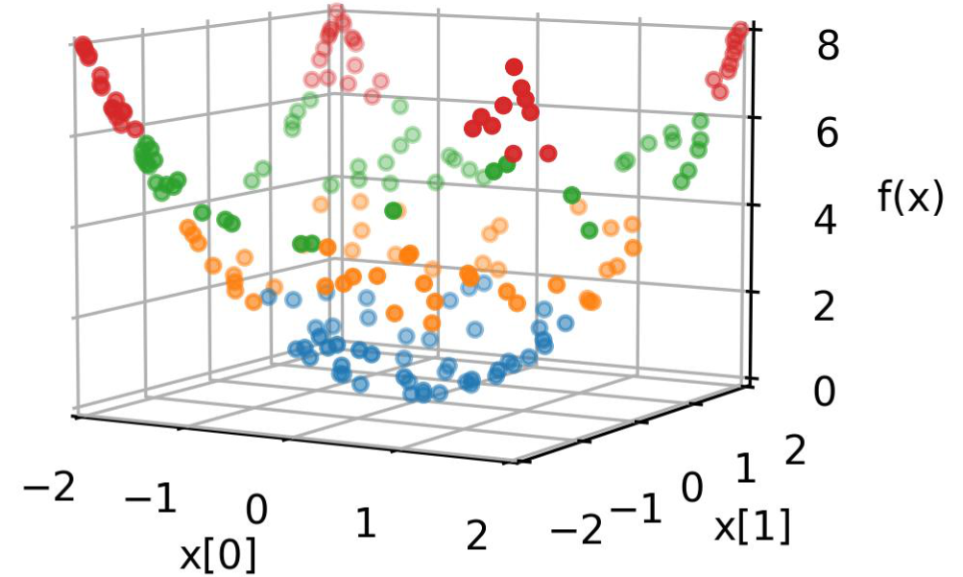
Issues with traditional greedy searches
Full Quadric Surface
Objective-based search
Novelty search
Novelty search is good at broadly covering the search space when
trying to gain an understanding of the search in an exploratory fashion

Slide 27
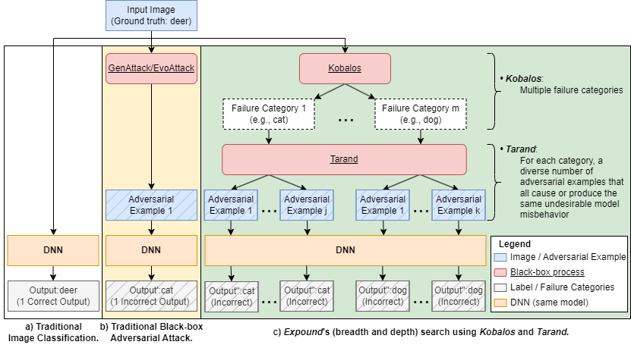
How our work differs
Image classification
algorithms e.g., ResNet-20
Existing work for
Adversarial Attacks
e.g., GenAttack [32], EvoAttack [14]
Our work (Expound)
Notes:
Related work slide for expound. Each box will be hidden to reveal underlying content

Slide 28
Methodology
Two step framework with novelty search
[coarse grained] Kobalos: Identify the failure categories (ways the model can fail)
Misclassifies a deer as a dog, a cat, a truck, etc.
[fine grained] Tarand: For each failure category, identify a number of increasingly different faults that lead to the same misbehavior
Different noise that all lead to the same misclassification
Exploration and exploitation paradigm [38]

Slide 29
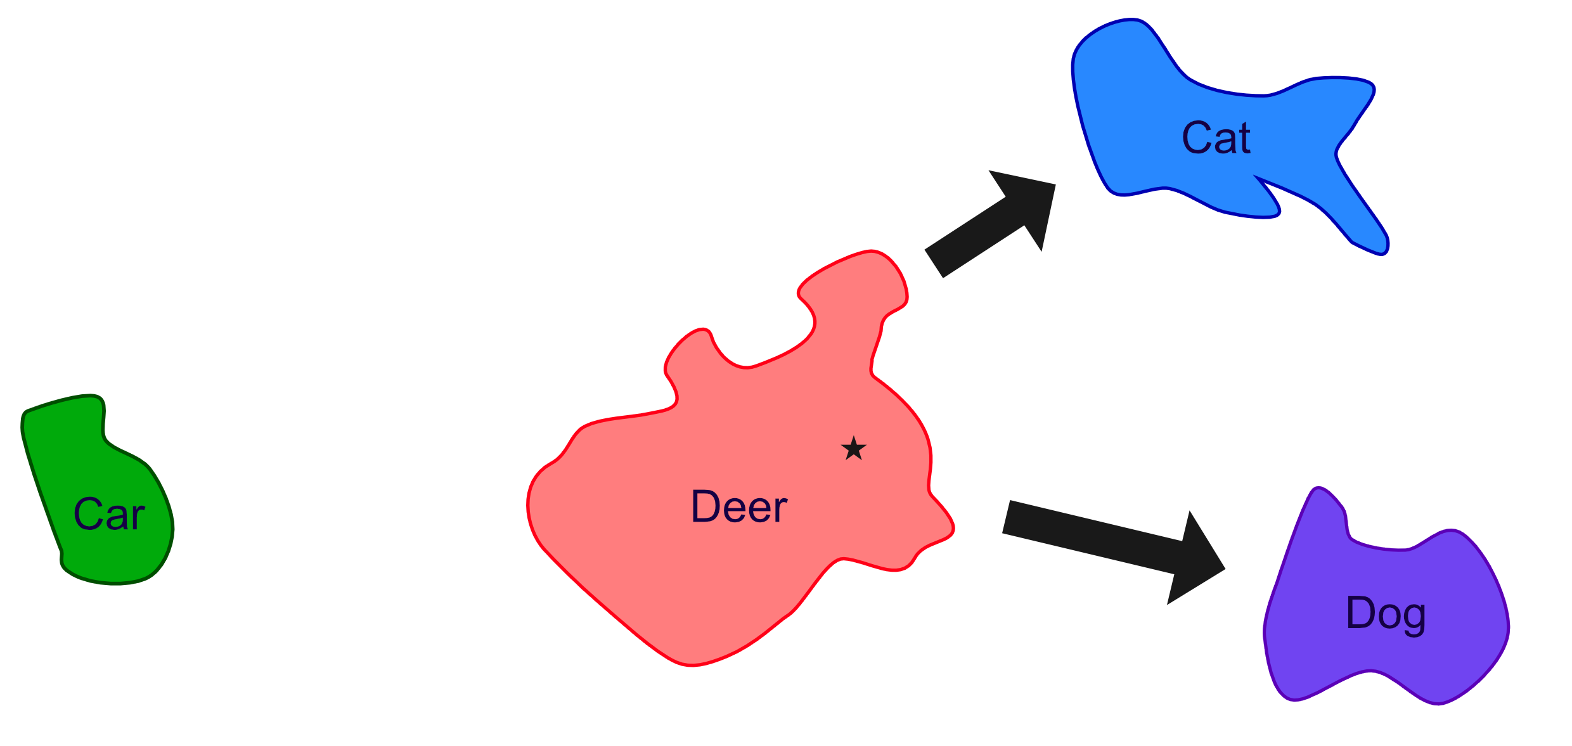
Visualization: coarse-grained diversity

Slide 30
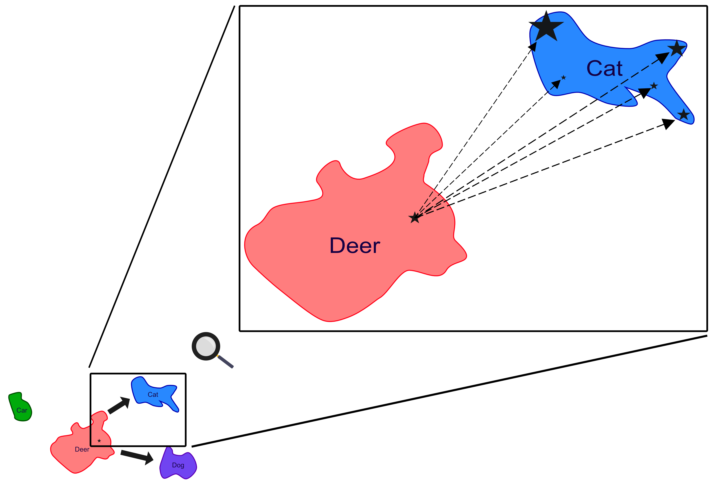
Visualization: fine-grained diversity

Slide 31
Validation
Datasets (data agnosticism)
[image] CIFAR10 [39]
[image] German Traffic Sign Recognition Benchmark (GTSRB) [40]
[audio] Google Speech Commands [41]
Models (model agnosticism)
ResNet-20 [42]
MobileNet-V2 [43]
AST (transformer-based) [44]
Applications (domain agnosticism)
Commonly used image benchmark
Autonomous driving
Audio

Slide 32
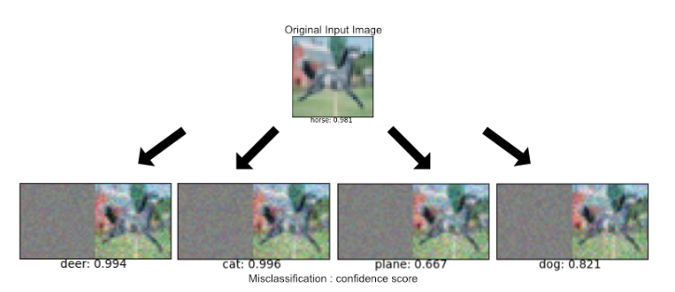
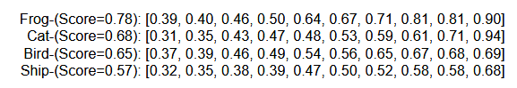
Example outputs
Diversity in (incorrect) labels
Diversity for each category
Each number represents an
adversarial example
Horse: 92.1%
Deer: 99.4%
Cat: 99.6%
Plane: 66.7%
Dog: 82.1%
Label 1
Label 2
Label 3
Label 4

Slide 33
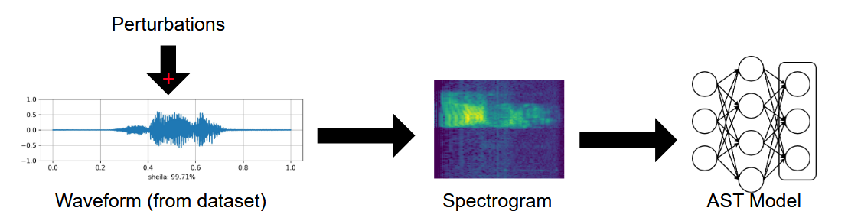
New Domain: Audio Adversarial Examples

Slide 34
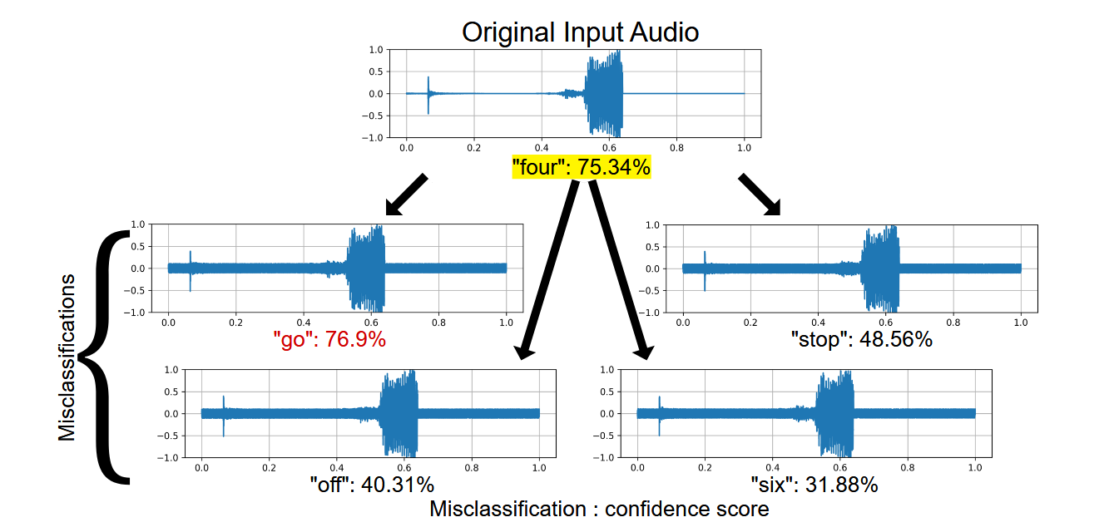
Audio adversarial examples

Slide 35
Expound summary and contributions
Innovation and impact on community
First work to show exploration and exploitation use of novelty search in search-based testing of AI-based systems
Identification of categories and diversity within categories
Technical
Black-box approach to generate diverse adversarial examples
No restriction on the type of data and ML algorithm used

Slide 36
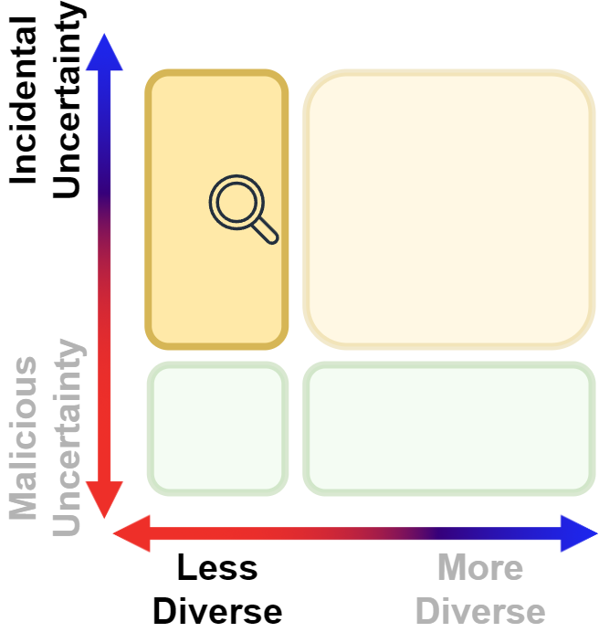
SavviDriver
[18] Kenneth H Chan, Sol Zilberman, Nick Polanco, Joshua E Siegel, and B.H.C. Cheng. SafeDriveRL: Combining non-cooperative game theory with reinforcement learning to explore and mitigate human-based uncertainty for autonomous vehicles. In Proceedings of the 19th International Symposium on Software Engineering for Adaptive and Self-Managing Systems, pages 214–220, 2024
[19] Kenneth H Chan, Sol Zilberman, and B.H.C. Cheng. SavviDriver: Model-based framework for game-based testing of autonomous vehicles in diverse multi-agent traffic scenarios. Software and Systems Modeling, 2025. (In press)

Slide 37
Objectives
Asset to be protected: LES
The behavior of the AV as a whole, which uses one or more LEC(s)
Threat: incidental human-based exploitative uncertainty
Type of data generated: Single type of failure
Notes:
Compared to

Slide 38
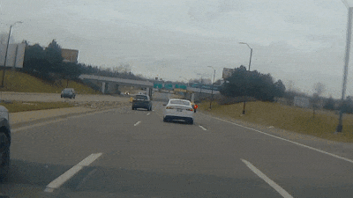
Motivation
AVs must deliver safe behavior in addition to satisfying functional requirements
The use of black-box ML components raises concerns regarding their ability to handle uncertainty
Humans in the operating context contributes as a source of epistemic uncertainty

Slide 39

Game-based testing
Model agents in the traffic scenario as a game [45]
Each agent has some objective (functional and non-functional)
Solve the game to discover types of strategies they may use
What will I do next?
Non-ego vehicle
Our objective: train this player
Ego vehicle (AV under study)
Notes:
Non-ego and ego (whos causing the problem and why do you care)

Slide 40
Existing work
Assumes either full cooperative setup [46] or malicious intentions [47, 48]
Does not capture how humans drive on the road

Slide 41
Insight
We observe that humans on the road:
cannot communicate with AVs
focus only on their individual objectives
(typically) do not explicitly exhibit adversarial behaviors
are not aware of objectives of other vehicles
As such, a non-cooperative game theory setup best captures the relationship between humans and AV for testing
Players focus on their own reward
Their actions may have an unseen or undesirable effects on other players

Slide 42
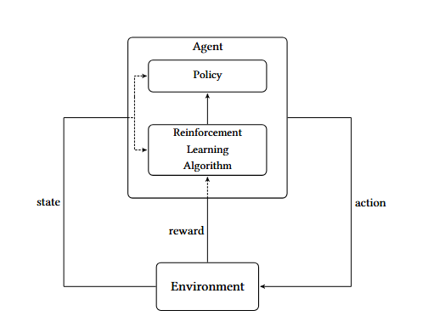
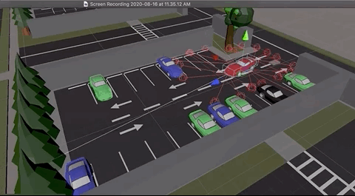
Reinforcement Learning
RL [49] is used to operationally realize agents in game-based testing
Cite: https://medium.com/xrpractices/
autonomous-car-parking-using-ml-agents-d780a366fe46

Slide 43
Top-down approach
Define the functional objectives of the human
What the non-ego vehicle should do
Define the non-functional objective of the human
How the non-ego vehicle will achieve the functional objective
Use game-based testing to discover test cases that satisfy the objectives

Slide 44
RL reward (for an aggressive vehicle)
Functional
Reach the destination
Maintain distance to nearby objects
Minimize travel time
Non-functional (aggressive)
Can go above speed limit
Can be closer to other vehicles
[ dist(current, target) close to 0 ]
[ dist(current, obj) >= 10 units ]
[ simulator.getTime() – simulator.startTime() ]
[ (current.speed – speedlimit) >= 5 ]
[ dist(current, obj) >= 5 ]

Slide 45
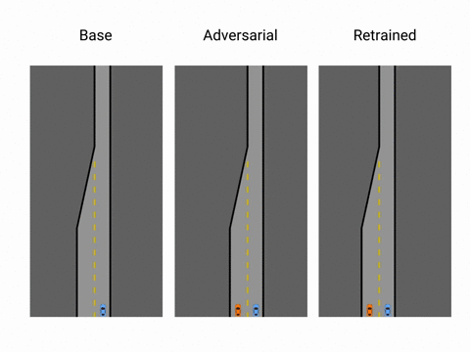
Results (merge lane)
Base
Uncertainty
Retrained

Slide 46
Challenges with reward shaping
Reward shaping is a messy process
Reward function is a complex mathematical equation in code
Difficult to change
Difficult to interpret
Difficult to add new objectives

Slide 47
RL reward (for an aggressive vehicle)
Functional
Reach the destination
Maintain distance to nearby objects
Minimize travel time
Non-functional (aggressive)
Can go above speed limit
Can be closer to other vehicles
[ dist(current, target) close to 0 ]
[ dist(current, obj) >= 10 units ]
[ simulator.getTime() – simulator.startTime() ]
[ (current.speed – speedlimit) >= 5 ]
[ dist(current, obj) >= 5 ]
Black: goals described in natural language
Purple: corresponding mathematical representation in simulation

Slide 48
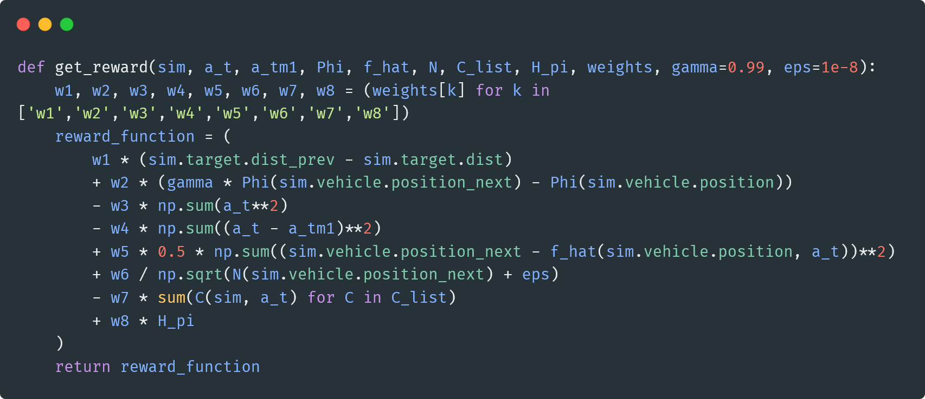
Reward shaping (and complexity in code)

Slide 49
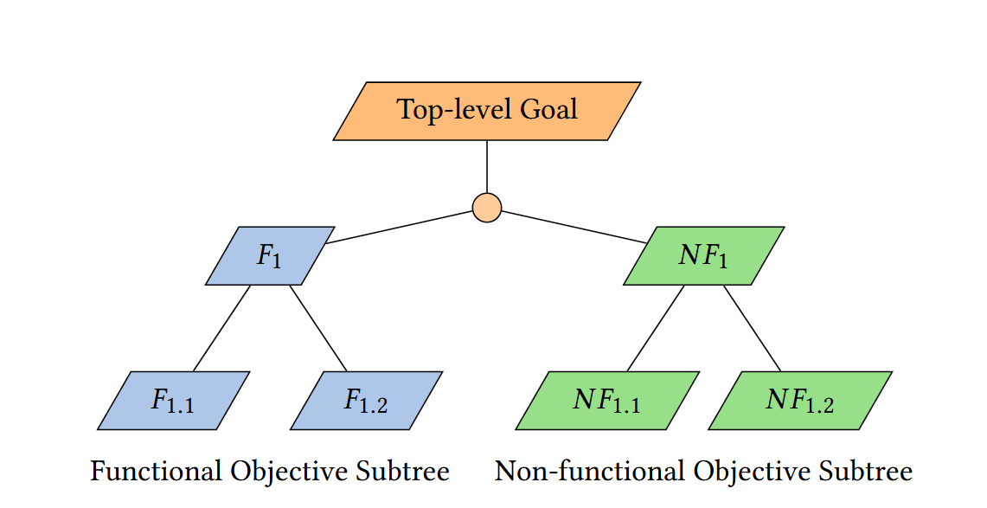
Goal-based models
Flow chart / tree-like structure
Root node is the high-level objective
Decompose into subobjectives
Leaf-level nodes are single
low-level requirements
Utility functions

Slide 50
Model-based approach
Goal-based models to refine to low-level requirements
Flow chart/tree-like structure
Decompose into low-level requirements
Utility function to assess satisfaction at leaf-levels
Aggregate the utility functions for reward function
Post-order tree traversal

Slide 51
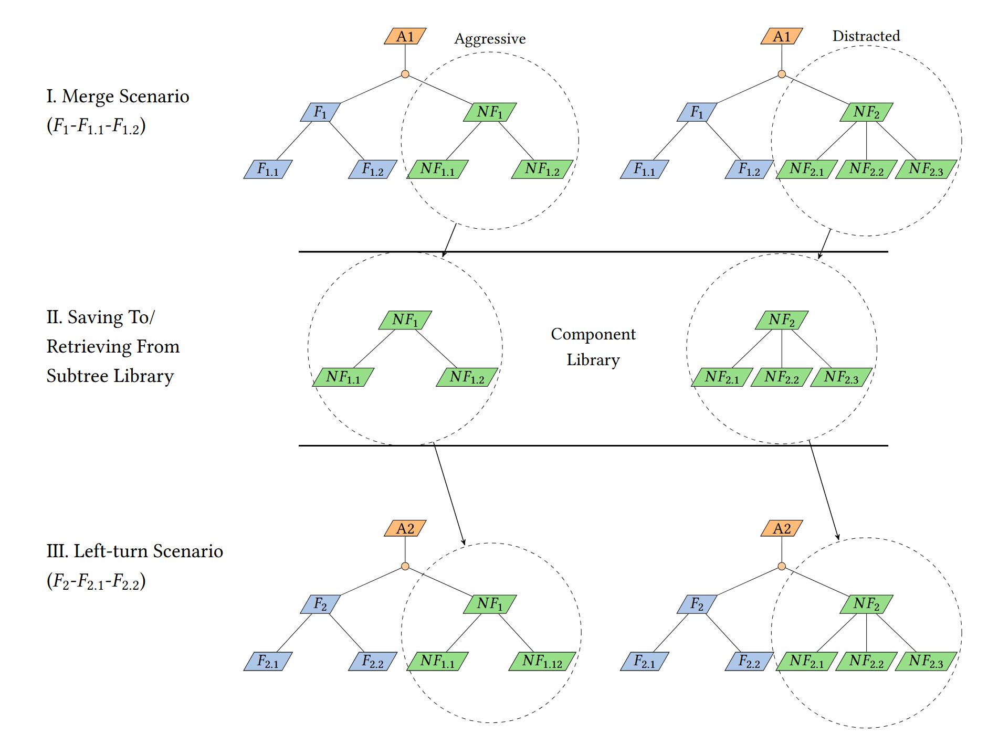
Reusability
Aggressive
Distracted
Blue F1: Merge
Component
Library
Blue F2: Left Turn

Slide 52
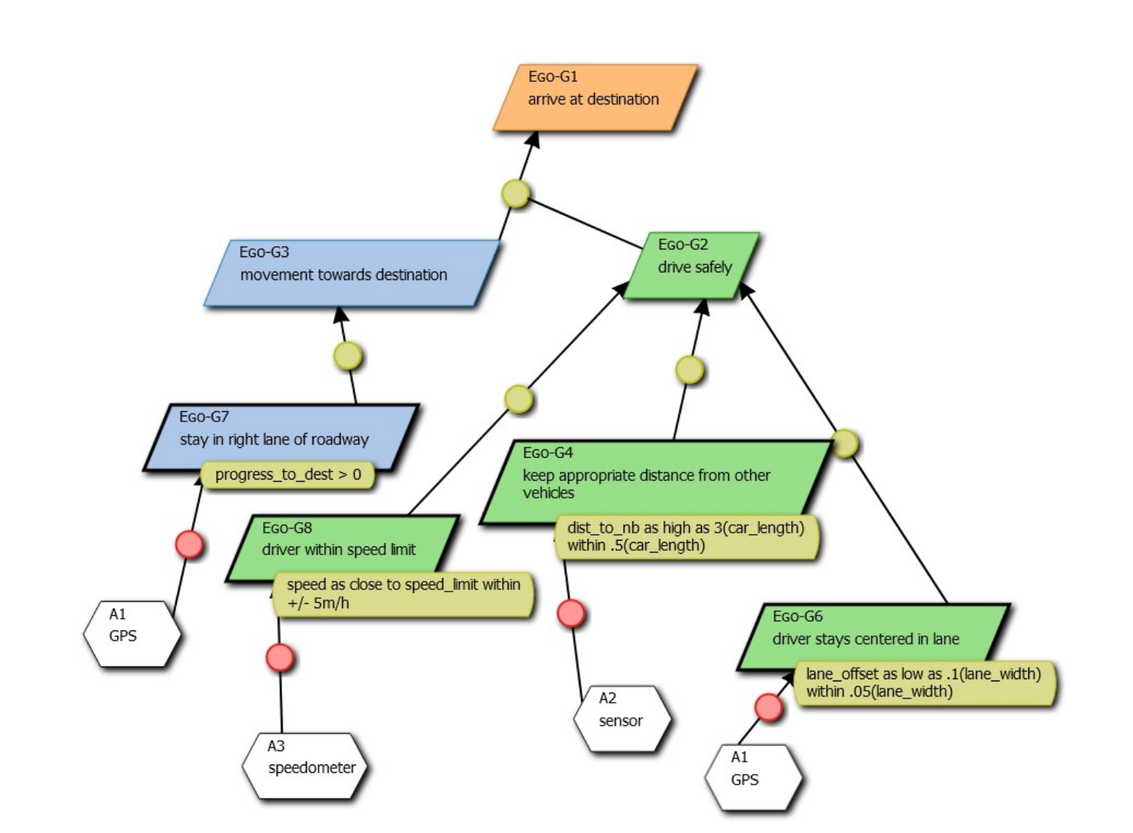


Use cases in SavviDriver
Goal model for the EGO AV
Utility functions are low-level
requirements
Traverse tree to form
reward function

Slide 53
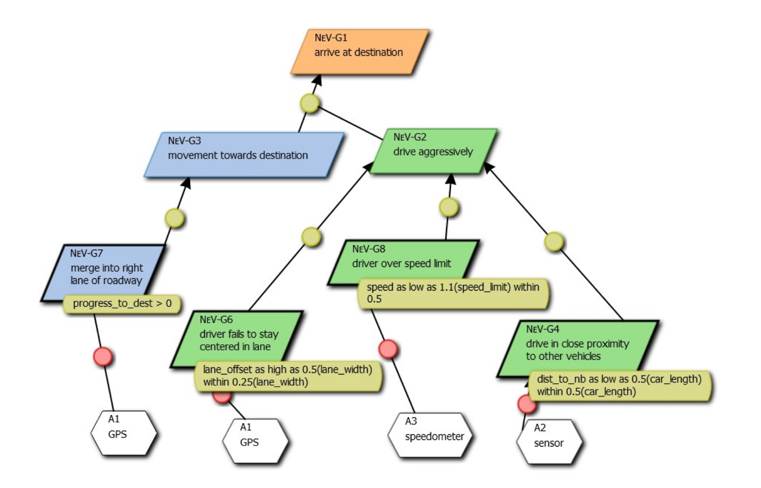
Use case (cont.)
Goal model for an aggressive NeV

Slide 54
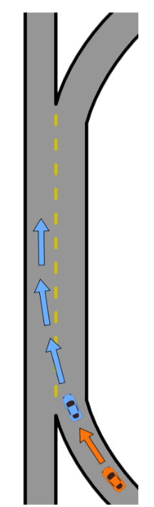
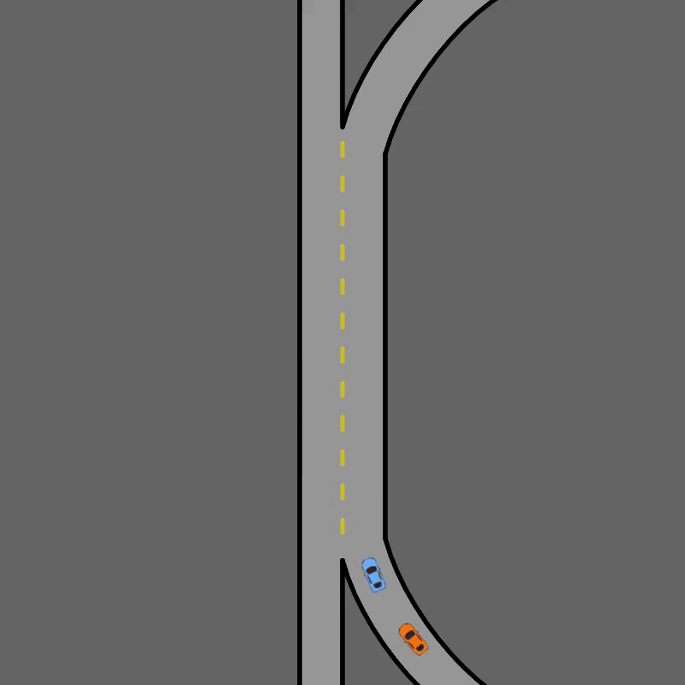
Use case: Highway Weave Lanes

Slide 55
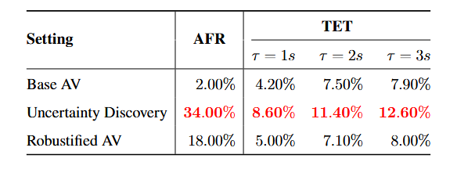
Data Table
Notes:
Have instead a related work slide

Slide 56
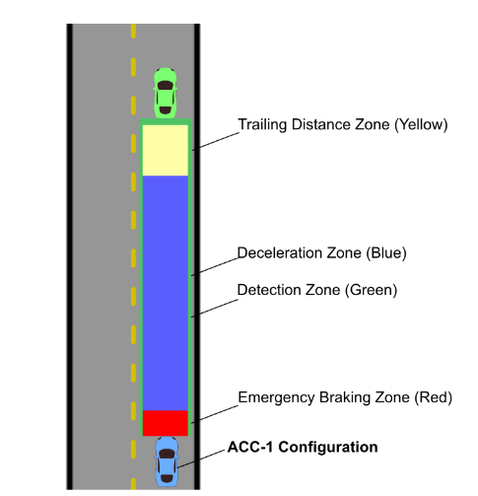
Use case: Adaptive Cruise Control
Notes:
Curise control

Slide 57
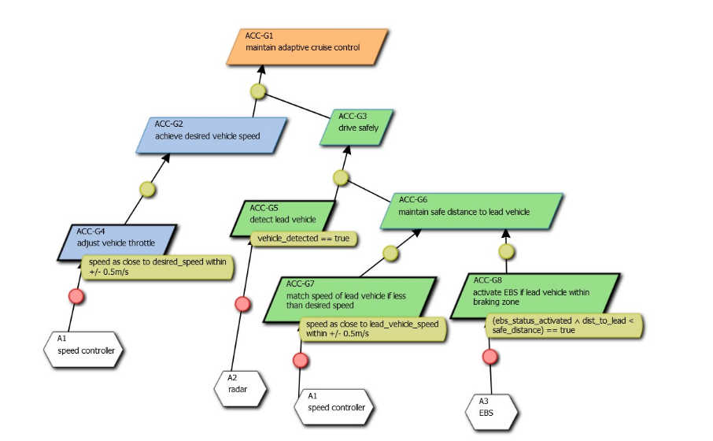
Goal model for ACC

Slide 58

Adaptive cruise control (cont.)

Slide 59
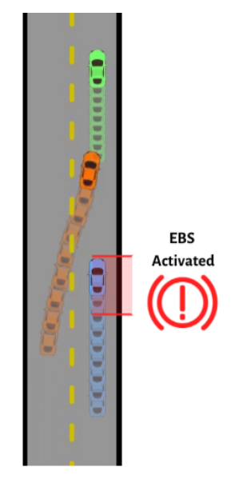
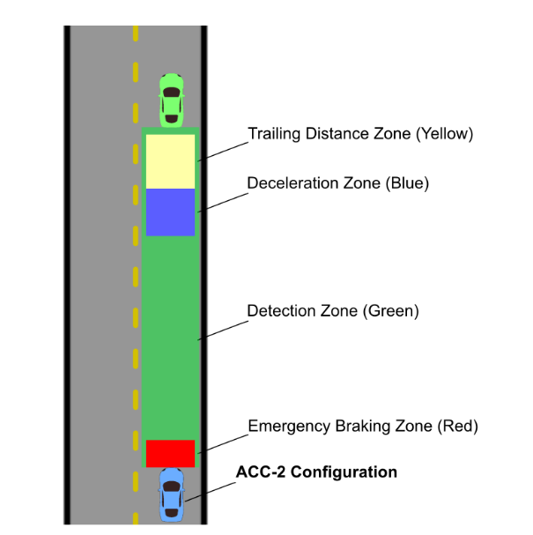
Use case: Adaptive Cruise Control

Slide 60
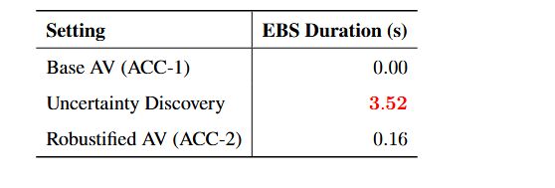
Numeric results ACC EBS duration

Slide 61
Discussion
Systematic approach to designing rewards
Forces developers to think about the problem
Interpretability
Modifications to requirements
Addition of new requirements
Modularity
Composability

Slide 62
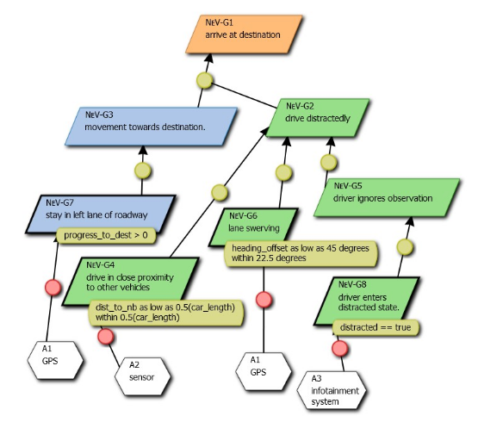
Distracted goal tree

Slide 63
Summary and contributions
Innovation and impact on community
Synthesis of non-cooperative game theory and RL for testing
Model-based approach for reward shaping
Technical
Game-based testing of AVs
Human-based uncertainty discovery and robustification
Top-down approach

Slide 64
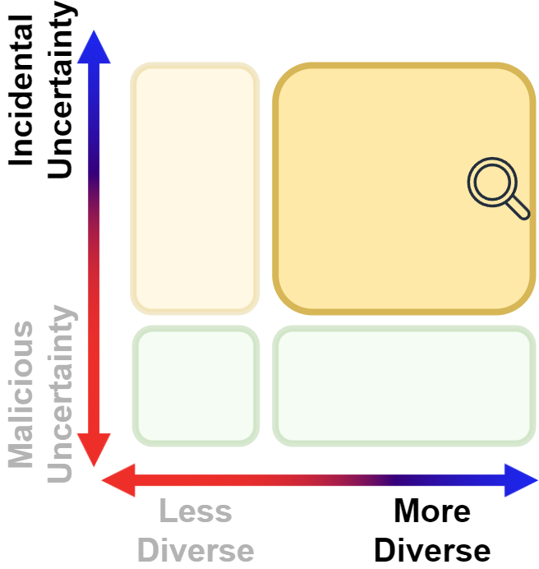
EvoDriver
[20] Sol Zilberman, Kenneth H Chan, and B.H.C. Cheng. EvoDriver: Novelty-search driven evolution of behavioral test suites for autonomous vehicles, 2025. (Submitted for publication)

Slide 65
Objectives
Asset to be protected: LES
The behavior of the AV as a whole, which uses one or more LEC(s)
Threat: incidental human-based exploitative uncertainty
Type of data generated: Diversity-driven
Notes:
Compared to

Slide 66
Motivations
Previous chapter described a top-down testing approach
Can we investigate a bottom-up, exploratory approach
One experiment leads to
Good
Bad
Unexpected
Avoids deceptive landscapes
Do not have to specify any search criteria

Slide 67





Merge case scenario (bottom up search)
Non-ego vehicle
Our objective: evolve controllers
Ego vehicle (AV under study)
Our objective: identify diverse responses
Notes:
Add more lines to the nonego

Slide 68
Key ideas
Encode vehicle controllers as Behavior Trees (BT) [50]
Leaf nodes are atomic actions
Evolve trees using Genetic Programming (GP) [51]
Objective: novelty based on the states of the ego over an episode

Slide 69


Behavior Trees
Used for robotics controllers [52, 53]
Popular for enemy AI in video games
Controllers for robotic tasks
Tree-like structure
Node can encode information or executable program
BT Legend
Notes:
And / or
Describe pink nodes
Selector tries each one of them
Sequences tries to execute all children until one fails.
Condition nodes are checks to continue

Slide 70

Genetic Programming
Evolves tree-like programs [51]
Crossover operation
Mutation operation

Slide 71



Evolving controllers
Non-ego vehicle
Our objective: evolve controllers
Ego vehicle (AV under study)
Our objective: identify diverse responses
Notes:
Add more lines to the nonego

Slide 72
Search objective
Diversity in the response of Ego vehicle behaviors (AV)
Measure the AV’s state, <position, velocity, heading>, during each timestep
Encourage maximum diversity in the sequence of states through the scenario

Slide 73

Grammar table

Slide 74


Results
Tested on two common traffic accident scenarios for AVs [54, 55]
Merge lane
Sharp left turn angled intersection

Slide 75

Metrics
Evaluate into three categories, based on time-to-collision (TTC) [56]
Projected trajectory of the vehicle (system under study)
We consider τ = 2, based on state-of-the-art and safety research

Slide 76

Example (single test case)
Notes:
Animate this slide to reveal the slides

Slide 77


Quantitative (Merge lane)
*Even distribution is better (more diverse)
Notes:
**fewer
Left – hide thr right

Slide 78

Novelty scores

Slide 79

Qualitative (Merge lane)
Each line is a test case
Adversarial
Minimize AV success
Thick bands (similar test cases)
Collision
Near miss
Success
Notes:
Unfold one graphic at a time
Swap order follow of previous side.
Move legend to upper right; ccopy the quantitative result over

Slide 80



Qualitative (Merge lane)
Collision
Collision
Near miss
Near miss
Success
EvoDriver
EvoDriver
Monte Carlo
Adversarial

Slide 81
Single experiment archive
Test case 1: No effect
Test case 2: Near miss
Test case 3: Collision

Slide 82


Slide 83
Left-turn use case
Ego vehicle (AV under study)
Our objective: identify diverse responses
Non-ego vehicle
Our objective: evolve controllers

Slide 84


Quantitative (Left-turn)

Slide 85



Qualitative (Left-turn)
Collision
Near miss
Success
EvoDriver
Monte Carlo
Adversarial

Slide 86

Novelty scores

Slide 87
EvoDriver
Innovation and impact on community
Synthesize GP and BTs
Fully automated approach
No developer bias
Avoid manual reward tuning
Interpretability
Technical
Diversity-driven approach identify
misbehaviors or undesired interactions
Bottom-up approach

Slide 88
Summary

Slide 89
High-level Contributions
Developed a suite of search-based testing techniques to assess system robustness against human-based uncertainty
Intended for developers/testers to use during testing phases
LEC model developer (component)
LES developer (system)
Potentially reconfigurations of road traffic by regulators
Automatically discovers test cases and limitations of AI
Allows multiple executions on different processes
Avoid developer bias
Reduce developer burden
Identify test cases that leads to undesirable behavior before deployment, assure safety

Slide 90
Contributions
EvoAttack [14, 15]
Described a new class of adversarial attacks focusing on suppressing ability of ML algorithms to identify objects
Expound [16, 17]
Described a technique to identify diverse ways a ML algorithm can fail
SavviDriver [18, 19]
Described a top-down game-based testing approach to identify maneuvers that can result in previously unseen, undesirable behaviors
EvoDriver [20]
Described a bottom-up approach to discover diverse maneuvers that can lead to diverse behaviors in an AV under study

Slide 91
Contributions
Objective | Objective / Diversity | Target domain | Search-based
Suppress object detection capabilities [SSBSE2022, JASE2024] | Objective | LEC (object detector) | GA + refinements
Discover diverse adversarial failures [SSBSE2023, (Under review) JASE2025] | Diversity | LEC (image classifier) | GA + novelty search
Top-down uncertainty exploration [SEAMS2024, (In Press) SOSYM2025] | Objective | LES (autonomous vehicle) | Non-cooperative game theory + RL + goal models
Bottom-up exploratory approach to discover diverse failures in LES [(Submitted for publication)] | Diversity | LES (autonomous vehicle) | BT + GP + novelty search

Slide 92
Search-based Assurance Techniques for Learning-enabled Components and Systems
Objective | Name | Target Domain | Techniques | Search-criteria | Search-based
Adversarial ML Testing [SSBSE2022] | EvoAttack | LEC (object detector) | Black box data/model | Objective | GA
Discover Diverse Adverse Failures [SSBSE2023, submitted to JASE2025] | Expound | LEC (image classifier) | Black box data/model | Diversity | EC novelty search
Top-down human-based uncertainty exploration to address LES assurance [SEAMS2024,SoSym2025 (in press)] | SafeDriveRL SaVViDriver | LES (autonomous vehicle) | Goal models, utility functions | Objective | Game Theory, RL
Bottom-up human-based uncertainty diverse exploration to address LES assurance [submitted for publication] | EvoDriver | LES (autonomous vehicle) | Behavior Trees (BTs) | Diversity | GP, novelty search

Slide 93
Conclusion
AI is ubiquitous
Their correctness is not guaranteed in the face of uncertainty
We have presented different testing frameworks to discover undesirable behaviors in AI models during testing phase
Focus on different types of human-based uncertainty
Focus on single issue or diversity driven test cases
Overarching objectives
Developed a suite of automated testing approaches
Supplement and complement existing testing techniques
Systematic approaches to discover a wide spectrum of non-intuitive test cases
Notes:
Reiterate specific contributions for each chapter
Add eureka back
Cannot usetraditional SE approaches on AI
Sunmary
Innovation
Contribution

Slide 94
Future work
Assessing robustness in High-Fidelity simulators
Goal-based modeling for reward shaping
Run-time explainability for LESs
System robustification and mitigation strategies for uncertainties

Slide 95
Publications and Manuscripts
Sol Zilberman, Kenneth H Chan, and B.H.C. Cheng. EvoDriver: Novelty-search driven evolution of behavioral test suites for autonomous vehicles, 2025. (Submitted for publication)
Kenneth H Chan, Sol Zilberman, and B.H.C. Cheng. SavviDriver: Model-based framework for game-based testing of autonomous vehicles in diverse multi-agent traffic scenarios. Software and Systems Modeling, 2025. (In press)
Kenneth H Chan and B.H.C. Cheng. Expound: a diversity-driven black-box approach for categories of model and domain-agnostic adversarial examples, 2025. (Submitted for publication to the Journal of Automated Software Engineering)
Kenneth H Chan and B.H.C. Cheng. EvoAttack: Suppressive adversarial attacks against object detection models using evolutionary search. Automated Software Engineering, vol. 32, no. 3, 2025
Kenneth H Chan, Sol Zilberman, Nick Polanco, Joshua E Siegel, and B.H.C. Cheng. SafeDriveRL: Combining non-cooperative game theory with reinforcement learning to explore and mitigate human-based uncertainty for autonomous vehicles. In Proceedings of the 19th International Symposium on Software Engineering for Adaptive and Self-Managing Systems, pages 214–220, 2024
Kenneth H Chan and B.H.C. Cheng. Expound: A black-box approach for generating diversity-driven adversarial examples. In International Symposium on Search Based Software Engineering, pages 19–34. Springer, 2023

Slide 96
Publications and Manuscript (cont.)
Michael Austin Langford, Kenneth H Chan, Jonathon Emil Fleck, Philip K McKinley, and B.H.C. Cheng. MoDALAS: addressing assurance for learning-enabled autonomous systems in the face of uncertainty. Software and Systems Modeling, pages 1–21, 2023
Kenneth H Chan and B.H.C. Cheng. EvoAttack: An evolutionary search-based adversarial attack for object detection models. In Proceedings of the 14th IEEE Symposium on Search-Based Software Engineering, pages 83-97, Singapore, 2022
Michael Austin Langford, Kenneth H Chan, Jonathon Emil Fleck, Philip K McKinley, and B.H.C. Cheng. MoDALAS: Model-driven assurance for learning-enabled autonomous systems. In Proceedings of MODELS 2021: ACM/IEEE 24th International Conference on Model Driven Engineering Languages and Systems (MODELS), pages 207–216, Fukuoka, JP, 2021.
Kenneth H Chan, Matthew Pasco, and B.H.C. Cheng. Towards a blockchain framework for autonomous vehicle system integrity. SAE International Journal of Transportation Cybersecurity and Privacy Special Issue on System Safety and Cybersecurity, pages 19-38, 2021

Slide 97

Acknowledgement
Dr. Cheng
Committee members
All my professors

Slide 98




Acknowledgement
Parents, brother

Slide 99
Acknowledgement: Sol Zilberman
🧠His collaboration is a testament to the success of my dissertation, and plays a crucial role in the safety of future self-adaptive systems. Our research will leave a lasting impact on the future of ML systems.
🍝It is important to note that he was willing to eat my experiments every Wednesday, highlighting the rich and enduring trust between us
🚨Despite the challenges we faced — particularly those posed by the uncertainty of reviewer 2 — it is important to highlight our dedication to the revisions to ensure their success and publication.
👨🏼‍🤝‍👨🏼Our long friendship is not only strong — it’s a sign of trust and respect.
✅In summary: he is a cool guy

Slide 100




Acknowledgement friends
All my friends (including those joining online)
I don’t take a lot of pictures D:

Slide 101
BIBLIOGRAPHY
[1] C. Szegedy, A. Toshev, and D. Erhan, “Deep neural networks for object detection,” Advances in neural information processing systems, vol. 26, 2013.
[2] G. Nandita and T. M. Chandra, “Malicious host detection and classification in cloud forensics with DNN and SFLO approaches,” International Journal of System Assurance Engineering and Management, pp. 1–13, 2021. Publisher: Springer.
[3] E. M. Rudd, R. Harang, and J. Saxe, “MEADE: Towards a malicious email attachment detection engine,” in 2018 IEEE international symposium on technologies for homeland security (HST), pp. 1–7, 2018.
[4] J. Han, J. Davids, H. Ashrafian, A. Darzi, D. S. Elson, and M. Sodergren, “A systematic review of robotic surgery: From supervised paradigms to fully autonomous robotic approaches,” The International Journal of Medical Robotics and Computer Assisted Surgery, vol. 18, no. 2, p. e2358, 2022. Publisher: Wiley Online Library.
[5] W. Wachenfeld and H. Winner, “The release of autonomous vehicles,” Autonomous Driving: Technical, Legal and Social Aspects, pp. 425–449, 2016.
[6] J. C. Knight, “Safety critical systems: challenges and directions,” in Proceedings of the 24th International Conference on Software Engineering. ICSE 2002, pp. 547–550, 2002.
[7] Tschandl, Philipp, et al. "Comparison of the accuracy of human readers versus machine-learning algorithms for pigmented skin lesion classification: an open, web-based, international, diagnostic study." The lancet oncology 20.7 (2019): 938-947.
[8] Ranjan, Rajeev, et al. "Deep learning for understanding faces: Machines may be just as good, or better, than humans." IEEE Signal Processing Magazine 35.1 (2018): 66-83.
[9] Szegedy et al., “Intriguing properties of neural networks,” in International conference on learning representations, 2014
[10] Abdel-Aty and S. Ding, “A matched case-control analysis of autonomous vs human-driven vehicle accidents,” Nature Communications, vol. 15, no. 4931, pp. 1–12, 2024
[11] A. Der Kiureghian and O. Ditlevsen, “Aleatory or epistemic? does it matter?,” Structural safety, vol. 31, no. 2, pp. 105–112, 2009.

Slide 102
BIBLIOGRAPHY
[12] E. Hüllermeier and W. Waegeman, “Aleatoric and epistemic uncertainty in machine learning: An introduction to concepts and methods,” Machine learning, vol. 110, no. 3, pp. 457–506, 2021.
[13] Burton and B. Herd, “Addressing uncertainty in the safety assurance of machine-learning,” Frontiers in Computer Science, 2023. 5:1132580.
[14] K. H. Chan and B.H.C. Cheng, “EvoAttack: An evolutionary search-based adversarial attack for object detection models,” in Search-Based Software Engineering: 14th International Symposium, SSBSE 2022, Singapore, November 17–18, 2022, Proceedings, pp. 83–97, Springer, 2022.
[15] K. H. Chan and B.H.C. Cheng, “Evoattack: suppressive adversarial attacks against object detection models using evolutionary search,” Automated Software Engineering, vol. 32, no. 3, 2025.
[16] K. H. Chan and B.H.C. Cheng, “Expound: A black-box approach for generating diversity-driven adversarial examples,” in International Symposium on Search Based Software Engineering, pp. 19–34, Springer, 2023.
[17] K. H. Chan and B.H.C.. Cheng, “Expound: a diversity-driven black-box approach for categories of model and domain-agnostic adversarial examples,” 2025. (Submitted for publication to the Journal of Automated Software Engineering).
[18] K. H. Chan, S. Zilberman, N. Polanco, J. E. Siegel, and B.H.C. Cheng, “Safedriverl: Combining non-cooperative game theory with reinforcement learning to explore and mitigate human-based uncertainty for autonomous vehicles,” in Proceedings of the 19th International Symposium on Software Engineering for Adaptive and Self-Managing Systems, pp. 214–220, 2024.
[19] K. H. Chan, S. Zilberman, and B.H.C.. Cheng, “SavviDriver: Model-based framework for game-based testing of autonomous vehicles in diverse multi-agent traffic scenarios,” Software and Systems Modeling, 2025.
[20] S. Zilberman, K. H. Chan, and B.H.C.. Cheng, “EvoDriver: Novelty-search driven evolution of behavioral test suites for autonomous vehicles,” 2025. (Submitted for publication).
[21] N. Papernot, P. McDaniel, and I. Goodfellow, “Transferability in machine learning: from phenomena to black-box attacks using adversarial samples,” arXiv, 2016.

Slide 103
BIBLIOGRAPHY
[22] Goodfellow, J. Shlens, and C. Szegedy, “Explaining and harnessing adversarial examples,” in International conference on learning representations, 2015.
[23] L. Sun et al., “A survey of practical adversarial example attacks,” Cybersecurity, vol. 1, pp. 1–9, 2018.
[24] Lin et al., “Microsoft coco: Common objects in context,” in European conference on computer vision, pp. 740–755, Springer, 2014.
[25] Sun et al., “Scalability in perception for autonomous driving: Waymo open dataset,” in Proceedings of the IEEE/CVF conference on computer vision and pattern recognition, pp. 2446–2454, 2020
[26] Y. Cao, Z. He, L. Wang, W. Wang, Y. Yuan, D. Zhang, J. Zhang, P. Zhu, L. Van Gool, J. Han, and others, “VisDrone-DET2021: The vision meets drone object detection challenge results,” in Proceedings of the IEEE/CVF International conference on computer vision, pp. 2847–2854, 2021.
[27] S. Ren, K. He, R. Girshick, and J. Sun, “Faster R-CNN: Towards real-time object detection with region proposal networks,” Advances in neural information processing systems, vol. 28, 2015.
[28] T.-Y. Lin, P. Goyal, R. Girshick, K. He, and P. Dollár, “Focal loss for dense object detection,” in Proceedings of the IEEE international conference on computer vision, pp. 2980–2988, 2017.
[29] G. Jocher, A. Chaurasia, A. Stoken, J. Borovec, Y. Kwon, K. Michael, J. Fang, Z. Yifu, C. Wong, D. Montes, and others, “ultralytics/yolov5,” Zenodo, 2022.
[30] H. Xu, Y. Ma, H.-C. Liu, D. Deb, H. Liu, J.-L. Tang, and A. K. Jain, “Adversarial attacks and defenses in images, graphs and text: A review,” International Journal of Automation and Computing, vol. 17, no. 2, pp. 151–178, 2020. Publisher: Springer.
[31] J. Su, D. V. Vargas, and K. Sakurai, “One pixel attack for fooling deep neural networks,” IEEE Transactions on Evolutionary Computation, vol. 23, no. 5, pp. 828–841, 2019.
[32] M. Alzantot, Y. Sharma, S. Chakraborty, H. Zhang, C.-J. Hsieh, and M. B. Srivastava, “Genattack: Practical black-box attacks with gradient-free optimization,” in Proceedings of the genetic and evolutionary computation conference, pp. 1111–1119, 2019.

Slide 104
BIBLIOGRAPHY
[33] P. Vidnerová and R. Neruda, “Vulnerability of classifiers to evolutionary generated adversarial examples,” Neural Networks, vol. 127, pp. 168–181, 2020.
[34] A. Rozsa, E. M. Rudd, and T. E. Boult, “Adversarial diversity and hard positive generation,” in Proceedings of the IEEE conference on computer vision and pattern recognition workshops, pp. 25–32, 2016.
[35] M. A. Langford and B.H.C. Cheng, “Enki: a diversity-driven approach to test and train robust learning-enabled systems,” ACM Transactions on Autonomous and Adaptive Systems (TAAS), vol. 15, no. 2, pp. 1–32, 2021.
[36] M. A. Langford and B.H.C. Cheng, ““Know What You Know”: Predicting behavior for learning-enabled systems when facing uncertainty,” in 2021 International Symposium on Software Engineering for Adaptive and Self-Managing Systems (SEAMS), pp. 78–89, IEEE, 2021.
[37] Z. Aghababaeyan, M. Abdellatif, M. Dadkhah, and L. Briand, “Deepgd: A multi-objective black-box test selection approach for deep neural networks,” ACM Transactions on Software Engineering and Methodology, vol. 33, no. 6, pp. 1–29, 2024.
[38] M. Črepinšek, S.-H. Liu, and M. Mernik, “Exploration and exploitation in evolutionary algorithms: A survey,” ACM computing surveys (CSUR), vol. 45, no. 3, pp. 1–33, 2013.
[39] A. Krizhevsky, G. Hinton, and others, “Learning multiple layers of features from tiny images,” 2009.
[40] J. Stallkamp et al., “The gtsrb: a multi-class classification competition,” in The 2011 international joint conference on neural networks, pp. 1453–1460, IEEE, 2011.
[41] Warden, “Speech commands: A dataset for limited-vocabulary speech recognition,” CoRR, 2018.
[42] K. He, X. Zhang, S. Ren, and J. Sun, “Deep residual learning for image recognition,” in Proceedings of the IEEE conference on computer vision and pattern recognition, pp. 770–778, 2016.
[43] M. Sandler et al., “Mobilenetv2: Inverted residuals and linear bottlenecks,” in Proceedings of the IEEE conf. on CV and pattern rec, pp. 4510–4520, 2018.

Slide 105
BIBLIOGRAPHY
[44] Y. Gong, Y.-A. Chung, and J. Glass, “AST: Audio Spectrogram Transformer,” in Proc. Interspeech 2021, pp. 571–575, 2021.
[45] J. Nash, “Non-cooperative games,” Annals of Mathematics, vol. 54, no. 2, pp. 286–295, 1951.
[46] Y. Ma, W. Jiang, L. Zhang, J. Chen, H. Wang, C. Lv, X. Wang, and L. Xiong, “Evolving testing scenario generation and intelligence evaluation for automated vehicles,” Transportation Research Part C: Emerging Technologies, vol. 163, pp. 1–21, June 2024.
[47] K. Hao, W. Cui, Y. Luo, L. Xie, Y. Bai, J. Yang, S. Yan, Y. Pan, and Z. Yang, “Adversarial Safety-Critical Scenario Generation using Naturalistic Human Driving Priors,” IEEE Transactions on Intelligent Vehicles, pp. 1–16, 2023
[48] A. Wachi, “Failure-scenario maker for rule-based agent using multi-agent adversarial reinforcement learning and its application to autonomous driving,” in Proceedings of the Twenty-Eighth International Joint Conference on Artificial Intelligence, IJCAI-19, pp. 6006–6012, International Joint Conferences on Artificial Intelligence Organization, 7 2019.
[49] K. Arulkumaran, M. P. Deisenroth, M. Brundage, and A. A. Bharath, “Deep reinforcement learning: A brief survey,” IEEE Signal Processing Magazine, vol. 34, no. 6, pp. 26–38, 2017.
[50] M. Colledanchise and P. Ögren, Behavior trees in robotics and AI: An introduction. CRC Press, 2018.
[51] W. B. Langdon and R. Poli, Foundations of genetic programming. Springer Science & Business Media, 2013
[52] Shoulson, Alexander, et al. "Parameterizing behavior trees." International conference on motion in games. Berlin, Heidelberg: Springer Berlin Heidelberg, 2011.
[53] Ögren, Petter, and Christopher I. Sprague. "Behavior trees in robot control systems." Annual Review of Control, Robotics, and Autonomous Systems 5.1 (2022): 81-107.
[54] Media, NHTSA, “Driving behaviors reported for drivers and motorcycle operators involved in fatal crashes.” https://www.iii.org/fact-statistic/facts-statistics-aggressive-driving, 2021

Slide 106
BIBLIOGRAPHY
[55] W. Y. Mergia, D. Eustace, D. Chimba, and M. Qumsiyeh, “Exploring factors contributing to injury severity at freeway merging and diverging locations in ohio,” Accident Analysis & Prevention, vol. 55, pp. 202–210, 2013
[56] M. Saffarzadeh, N. Nadimi, S. Naseralavi, and A. R. Mamdoohi, “A general formulation for time-to-collision safety indicator,” in Proceedings of the Institution of Civil Engineers Transport, vol. 166, pp. 294–304, Thomas Telford Ltd, 2013.

Slide 107

Conclusion
AI is ubiquitous
Their correctness is not guaranteed in the face of uncertainty
We have presented different testing frameworks to discover undesirable behaviors in AI models during testing phase
Focus on different types of human-based uncertainty
Focus on single issue or diversity driven test cases
Overarching objectives
Developed a suite of automated testing approaches
Supplement and complement existing testing techniques
Systematic approaches to discover a wide spectrum of non-intuitive test cases
Notes:
Reiterate specific contributions for each chapter
Add eureka back
Cannot usetraditional SE approaches on AI
Sunmary
Innovation
Contribution

